Slide 1
Recurrences
David Kauchak
cs140
Spring 2024

Slide 2
Administrative
How was assignment 0?
Mentor hours posted
Group assignment: must attend mentor hours on Thursday or Friday and submit group assignment
Assignment 1 (due Sunday): must work with different partner

Slide 3
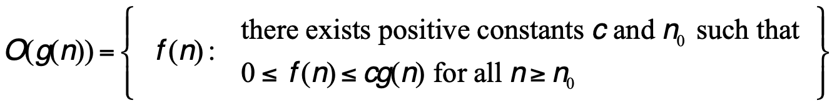
Big O: Upper bound
O(g(n)) is the set of functions:

Slide 4
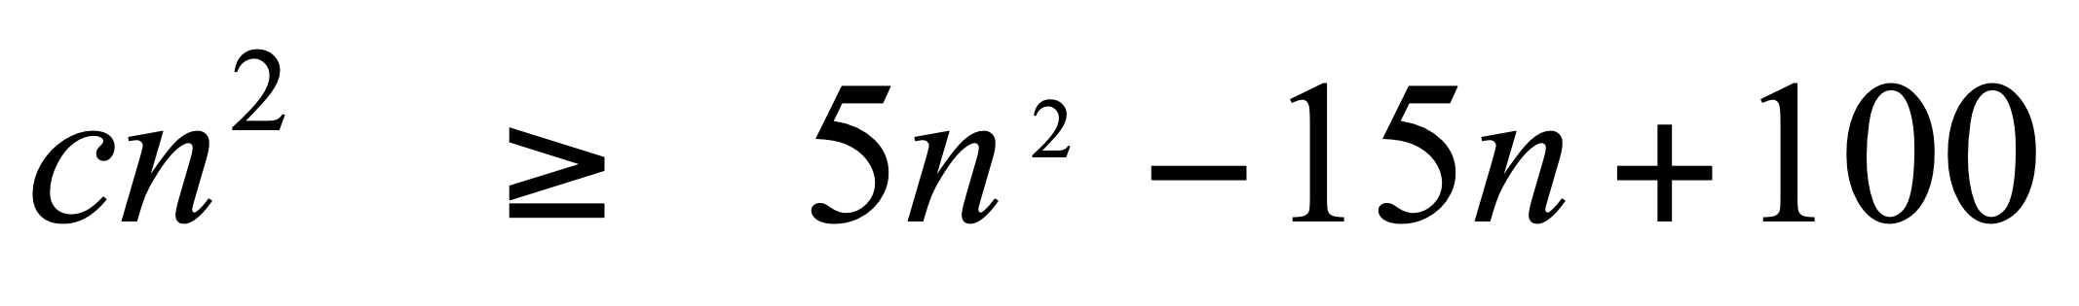
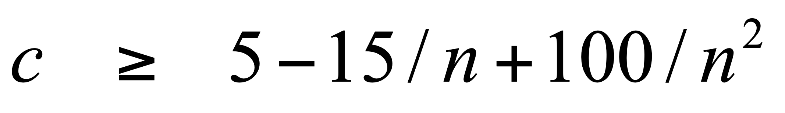
Proving bounds: find constants that satisfy inequalities
Show that 5n² – 15n + 100 is Θ(n²)
Step 1: Prove O(n²) – Find constants c and n₀ such that 5n² – 15n + 100 ≤ cn² for all n > n₀
Let n₀ =1 and c = 5 + 100 = 105.
100/n² only gets smaller as n increases and we ignore -15/n since it only varies between -15 and 0

Slide 5
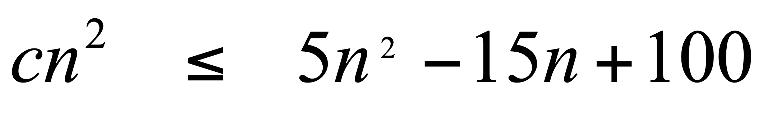
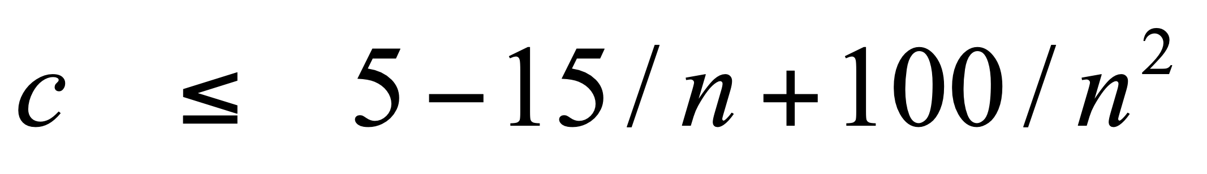
Proving bounds
Step 2: Prove Ω(n²) – Find constants c and n₀ such that 5n² – 15n + 100 ≥ cn² for all n > n₀
Let n₀ = 4 and c = 5 – 15/4 = 1.25 (or anything less than 1.25). -15/n is always increasing, and we ignore 100/n² since it is always between 0 and 100.

Slide 6
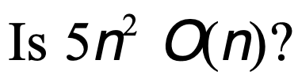
Bounds
No
How would we prove it?

Slide 7
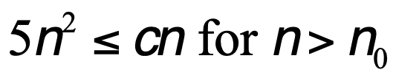

Disproving bounds
Assume it’s true.
That means there exists some c and n₀ such that
contradiction!

Slide 8
Divide and Conquer
Divide: Break the problem into smaller sub-problems
Conquer: Solve the sub-problems. Generally, this involves waiting for the problem to be small enough that it is trivial to solve (i.e., 1 or 2 items)
Combine: Given the results of the solved sub-problems, combine them to generate a solution for the complete problem

Slide 9
Divide and Conquer: some thoughts
Often, the sub-problem is the same as the original problem
Dividing the problem in half frequently does the job
May have to get creative about how the data is split
Splitting tends to generate run times with log n in them

Slide 10
Divide and conquer
One approach:
Pretend like you have a working version of your function, but it only works on smaller sub-problems
If you split up the current problem in some way (e.g., in half) and solved those sub-problems, how could you then get the solution to the larger problem?

Slide 11
Divide and Conquer: Sorting
How should we split the data?
What are the sub-problems we need to solve?
How do we combine the results from these sub-problems?

Slide 12
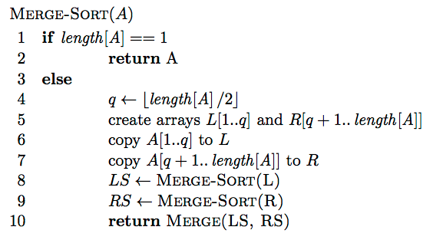
MergeSort

Slide 13
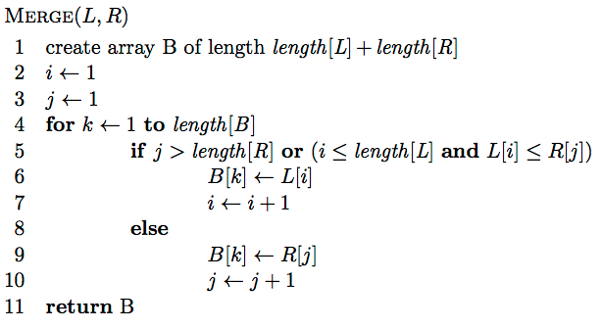
MergeSort: Merge
Assuming L and R are sorted already, merge the two to create a single sorted array

Slide 14
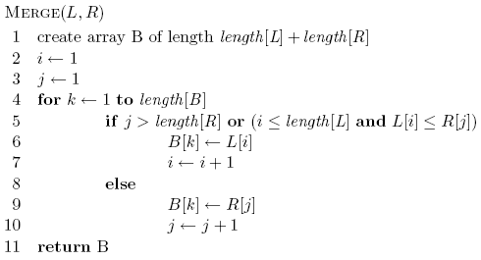
Merge
L: 1 3 5 8
R: 2 4 6 7

Slide 15
Merge
L: 1 3 5 8
R: 2 4 6 7
B:

Slide 16
Merge
i
j
L: 1 3 5 8
R: 2 4 6 7
B:

Slide 17
Merge
i
j
L: 1 3 5 8
R: 2 4 6 7
B:

Slide 18
Merge
i
j
L: 1 3 5 8
R: 2 4 6 7
B: 1

Slide 19
Merge
i
j
L: 1 3 5 8
R: 2 4 6 7
B: 1

Slide 20
Merge
i
j
L: 1 3 5 8
R: 2 4 6 7
B: 1 2

Slide 21
Merge
i
j
L: 1 3 5 8
R: 2 4 6 7
B: 1 2

Slide 22
Merge
i
j
L: 1 3 5 8
R: 2 4 6 7
B: 1 2 3

Slide 23
Merge
i
j
L: 1 3 5 8
R: 2 4 6 7
B: 1 2 3

Slide 24
Merge
i
j
L: 1 3 5 8
R: 2 4 6 7
B: 1 2 3 4

Slide 25
Merge
i
j
L: 1 3 5 8
R: 2 4 6 7
B: 1 2 3 4

Slide 26
Merge
i
j
L: 1 3 5 8
R: 2 4 6 7
B: 1 2 3 4 5

Slide 27
Merge
i
j
L: 1 3 5 8
R: 2 4 6 7
B: 1 2 3 4 5

Slide 28
Merge
i
j
L: 1 3 5 8
R: 2 4 6 7
B: 1 2 3 4 5 6

Slide 29
Merge
i
j
L: 1 3 5 8
R: 2 4 6 7
B: 1 2 3 4 5 6

Slide 30
Merge
i
j
L: 1 3 5 8
R: 2 4 6 7
B: 1 2 3 4 5 6 7

Slide 31
Merge
i
j
L: 1 3 5 8
R: 2 4 6 7
B: 1 2 3 4 5 6 7

Slide 32
Merge
i
j
L: 1 3 5 8
R: 2 4 6 7
B: 1 2 3 4 5 6 7 8

Slide 33
Merge
Does the algorithm terminate?

Slide 34
Merge
Is it correct?
Loop invariant: At the end of each iteration of the for loop of lines 4-10 the subarray B[1..k] contains the smallest k elements from L and R in sorted order.

Slide 35
Merge
Is it correct?
Loop invariant: At the beginning of the for loop of lines 4-10 the first k-1 elements of B are the smallest k-1 elements from L and R in sorted order.

Slide 36
Merge
Running time?

Slide 37
Merge
Running time? Θ(n) - linear

Slide 38
MergeSort
Running time?

Slide 39
Merge-Sort
Running time?
D(n): cost of splitting (dividing) the data
C(n): cost of merging/combining the data

Slide 40
Merge-Sort
Running time?
D(n): cost of splitting (dividing) the data - linear Θ(n)
C(n): cost of merging/combining the data – linear Θ(n)

Slide 41
Merge-Sort
Running time?
Which is?

Slide 42
Merge-Sort
cn
T(n/2)
T(n/2)

Slide 43
Merge-Sort
cn
cn/2
cn/2
T(n/4)
T(n/4)
T(n/4)
T(n/4)

Slide 44
Merge-Sort
cn
cn/2
cn/2
cn/4
cn/4
cn/4
cn/4
T(n/8)
T(n/8)
T(n/8)
T(n/8)
T(n/8)
T(n/8)
T(n/8)
T(n/8)

Slide 45
Merge-Sort
cn
cn/2
cn/2
cn/4
cn/4
cn/4
cn/4
cn/8
cn/8
cn/8
cn/8
cn/8
cn/8
cn/8
cn/8
…
c c c c c … c c c c c c

Slide 46
Merge-Sort
cn
cn
cn/2
cn/2
cn
cn/4
cn/4
cn/4
cn/4
cn
cn/8
cn/8
cn/8
cn/8
cn/8
cn/8
cn/8
cn/8
cn
…
c c c c c … c c c c c c
cn

Slide 47
Merge-Sort
cn
cn
cn/2
cn/2
cn
cn/4
cn/4
cn/4
cn/4
cn
cn/8
cn/8
cn/8
cn/8
cn/8
cn/8
cn/8
cn/8
cn
…
c c c c c … c c c c c c
cn
Depth?

Slide 48
Merge-Sort
We can calculate the depth, by determining when the recursion gets down to a small problem size, e.g., 1
At each level, we divide by 2

Slide 49
Merge-Sort
Running time?
Each level costs cn
log n levels
cn log n = Θ(n log n )
Why don’t we write it as n log₂ n?

Slide 50
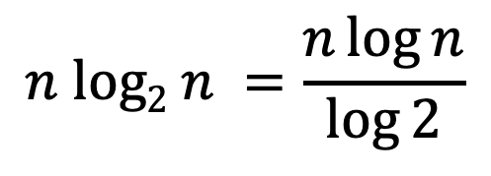
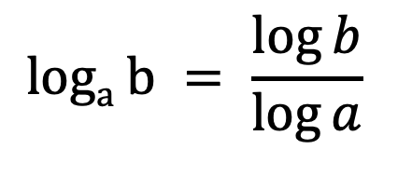
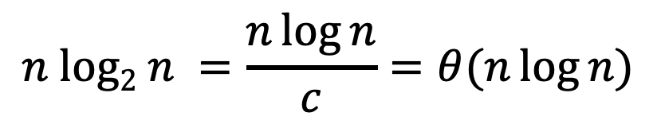
Log properties
$$loga b = \frac{\log{b}}{\log{a}}$$
$$n log2 n =\frac{n\log{n}}{\log{2}}$$
$$n log2 n =\frac{n\log{n}}{c}=θ(n\log{n})$$

Slide 51
Recurrence
A function that is defined with respect to itself on smaller inputs

Slide 52
Why are we interested in recurrences?
Computational cost of divide and conquer algorithms
a subproblems of size n/b
D(n) the cost of dividing the data
C(n) the cost of recombining the subproblem solutions
In general, the runtimes of most recursive algorithms can be expressed as recurrences

Slide 53
The challenge
Recurrences are often easy to define because they mimic the structure of the program
But… they do not directly express the computational cost, i.e., n, n², …
We want to remove self-recurrence and find a more understandable form for the function

Slide 54
Three approaches
Substitution method: when you have a good guess of the solution, prove that it’s correct.
Recursion-tree method: If you don’t have a good guess, the recursion tree can help
Calculate exactly (like we did with MergeSort).
Use it to get a good guess, then prove with substitution method.
Master method: Provides solutions for recurrences of the form:

Slide 55
Substitution method
Guess the form of the solution
Then prove it’s correct by induction
Halves the input then a constant amount of work
Guesses?

Slide 56
Substitution method
Guess the form of the solution
Then prove it’s correct by induction
Halves the input then a constant amount of work
Similar to binary search:
Guess: O(log n)

Slide 57
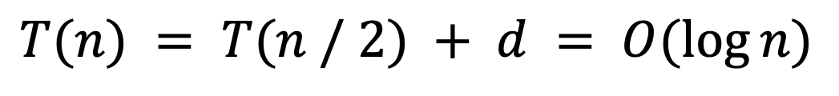
Proof?
$$T(n) = T(n / 2) + d = O(log⁡n)$$
Ideas?

Slide 58
Proof?
$$T(n) = T(n / 2) + d = O(log⁡n)$$
Proof by induction!
Assume it’s true for smaller T(k), i.e., k < n
prove that it’s then true for current T(n)

Slide 59
Assume T(k) = O(log k) for all k < n
Show that T(n) = O(log n)
From our assumption, T(n/2) = O(log n/2):
From the definition of big-O: T(n/2) ≤ c log(n/2)
How do we now prove T(n) = O(log n)?

Slide 60
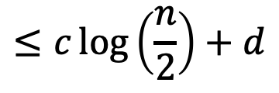
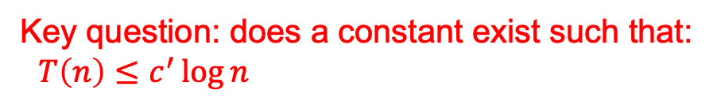



To prove that T(n) = O(log n) identify the appropriate constants:
i.e., some constant c’ such that T(n) ≤ c’ log n
$$T\left(n\right)=T(n/2)+d$$
$$≤c\log\left(\frac{n}{2}\right)+d$$
from our inductive hypothesis
$$≤c\log{n}−c\log{2}+d$$
$$≤c\log{n}−c+d$$
residual
Key question: does a constant exist such that:
$T\left(n\right)≤c^{′}\log{n}$

Slide 61
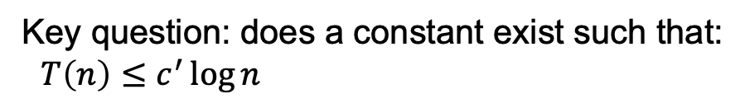


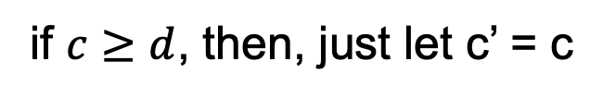
To prove that T(n) = O(log n) identify the appropriate constants:
i.e., some constant c’ such that T(n) ≤ c’ log n
Key question: does a constant exist such that:
$T\left(n\right)≤c^{′}\log{n}$
$$T\left(n\right)≤c\log{n}−c+d$$
if $c≥d$, then, just let c’ = c
$$T\left(n\right)≤c\log{n}−c+d≤c\log{n}$$

Slide 62

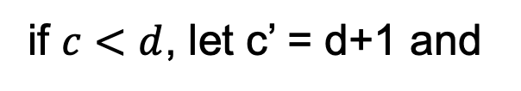
To prove that T(n) = O(log n) identify the appropriate constants:
i.e., some constant c’ such that T(n) ≤ c’ log n
Key question: does a constant exist such that:
$T\left(n\right)≤c^{′}\log{n}$
$$T\left(n\right)≤c\log{n}−c+d$$
if $c<d$, let c’ = d+1 and
$$T\left(n\right)≤c\log{n}−c+d≤d\log{n+\log{n} }$$

Slide 63
Base case?
For an inductive proof we need to show two things:
Show that it holds for some base case
Assuming it’s true for k < n show it’s true for n
What is the base case in our situation?

Slide 64
Guess the solution?
At each iteration, does a linear amount of work (i.e., iterate over the data) and reduces the size by one at each step
O(n²)
Assume T(k) = O(k²) for all k < n
again, this implies that T(n-1) ≤ c(n-1)²
Show that T(n) = O(n²), i.e., T(n) ≤ c’n²

Slide 65
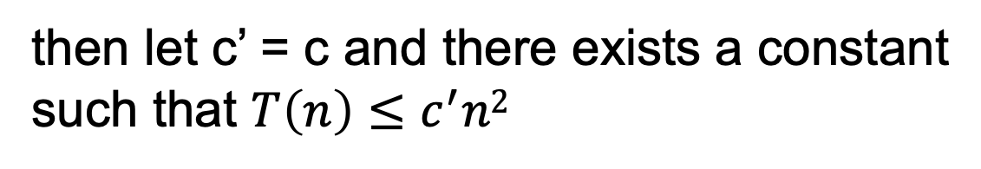
from our inductive hypothesis
residual
if
then let c’ = c and there exists a constant
such that $T\left(n\right)≤c^{′}n2$

Slide 66
from our inductive hypothesis
residual
which holds for any c ≥1 for n ≥1

Slide 67
Substitution method
Guess the form of the solution
Then prove it’s correct by induction
Halves the input then constant amount of work
Similar to binary search:
Guess: O(log₂ n)

Slide 68
Guess the solution?
Recurses into 2 sub-problems that are half the size and performs some operation on all the elements
O(n log n)
What if we guess wrong, e.g., O(n²)?
Assume T(k) = O(k²) for all k < n
again, this implies that T(n/2) ≤ c(n/2)²
Show that T(n) = O(n²)

Slide 69
from our inductive hypothesis
residual
if
overkill?

Slide 70
What if we guess wrong, e.g., O(n)?
Assume T(k) = O(k) for all k < n
again, this implies that T(n/2) ≤ c(n/2)
Show that T(n) = O(n)
factor of n so we can just roll it in?

Slide 71
What if we guess wrong, e.g., O(n)?
Assume T(k) = O(k) for all k < n
again, this implies that T(n/2) ≤ c(n/2)
Show that T(n) = O(n)
Must prove the exact form!
cn+n ≤ cn ??
factor of n so we can just roll it in?

Slide 72
Prove T(n) = O(n log₂ n)
Assume T(k) = O(k log₂ k) for all k < n
again, this implies that T(k) = ck log₂k
Show that T(n) = O(n log₂ n)
residual
if cn ≥ n, c > 1

